Slide 1
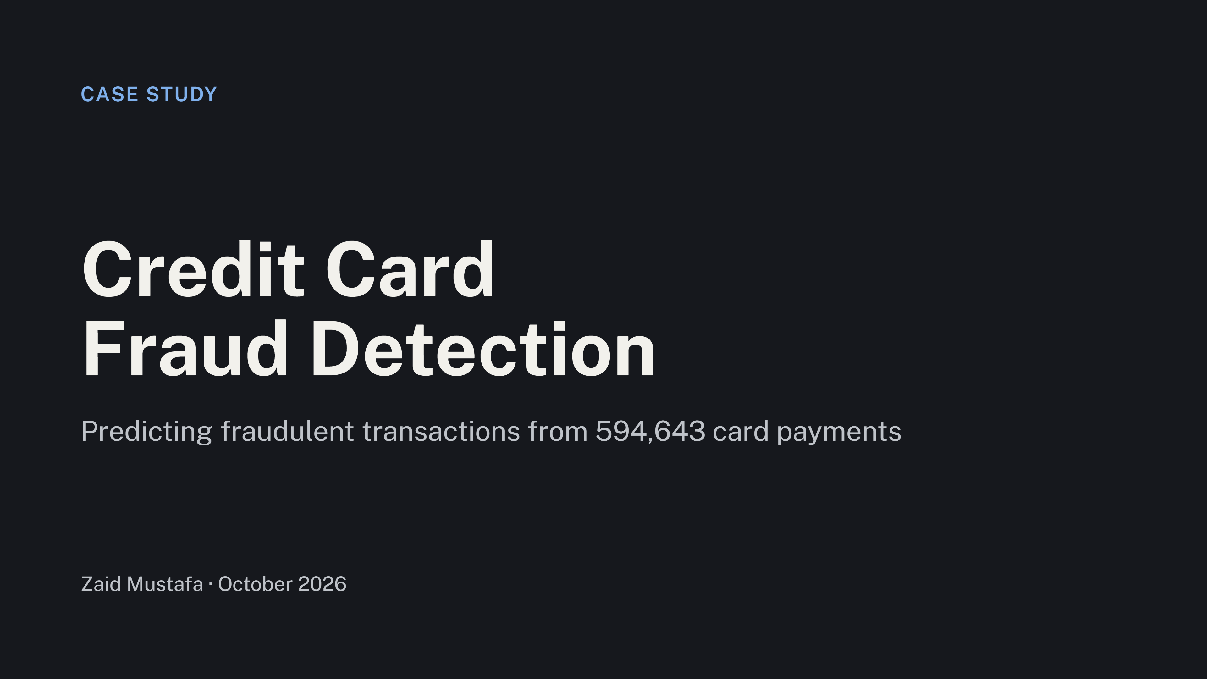
Case study
Credit Card
Fraud Detection
Predicting fraudulent transactions from 594,643 card payments
Zaid Mustafa · October 2026

Slide 2
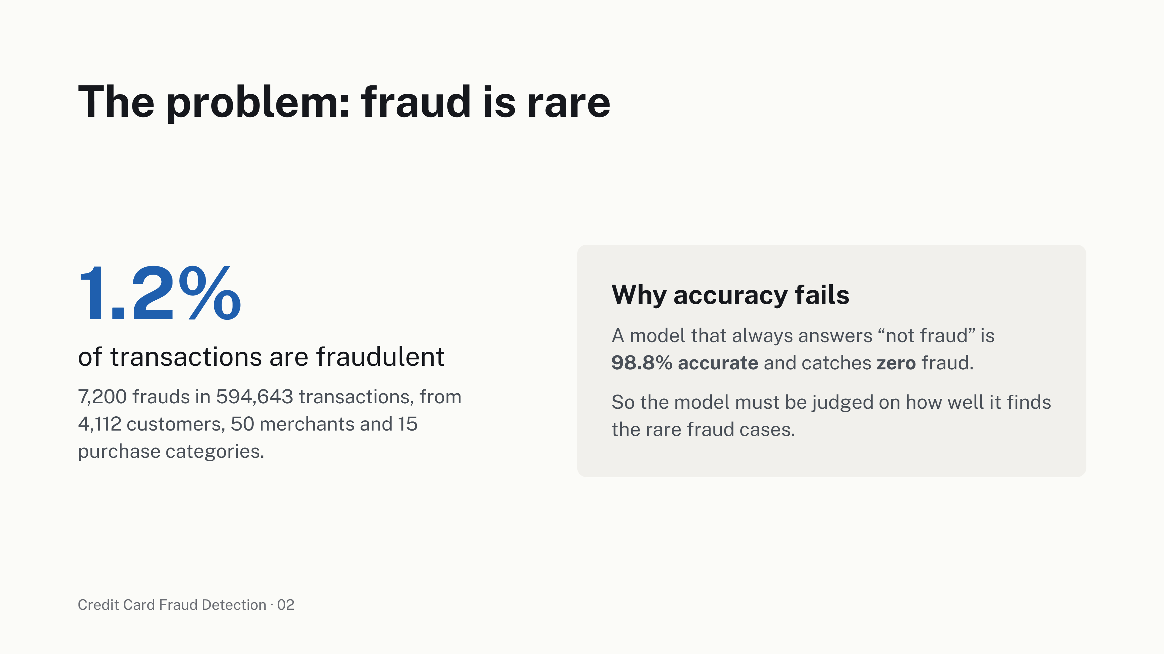
The problem: fraud is rare
1.2%
Why accuracy fails
A model that always answers “not fraud” is
of transactions are fraudulent
98.8% accurate
and catches
zero fraud.
7,200 frauds in 594,643 transactions, from
So the model must be judged on how well it finds
4,112 customers, 50 merchants and 15
the rare fraud cases.
purchase categories.
Credit Card Fraud Detection · 02

Slide 3
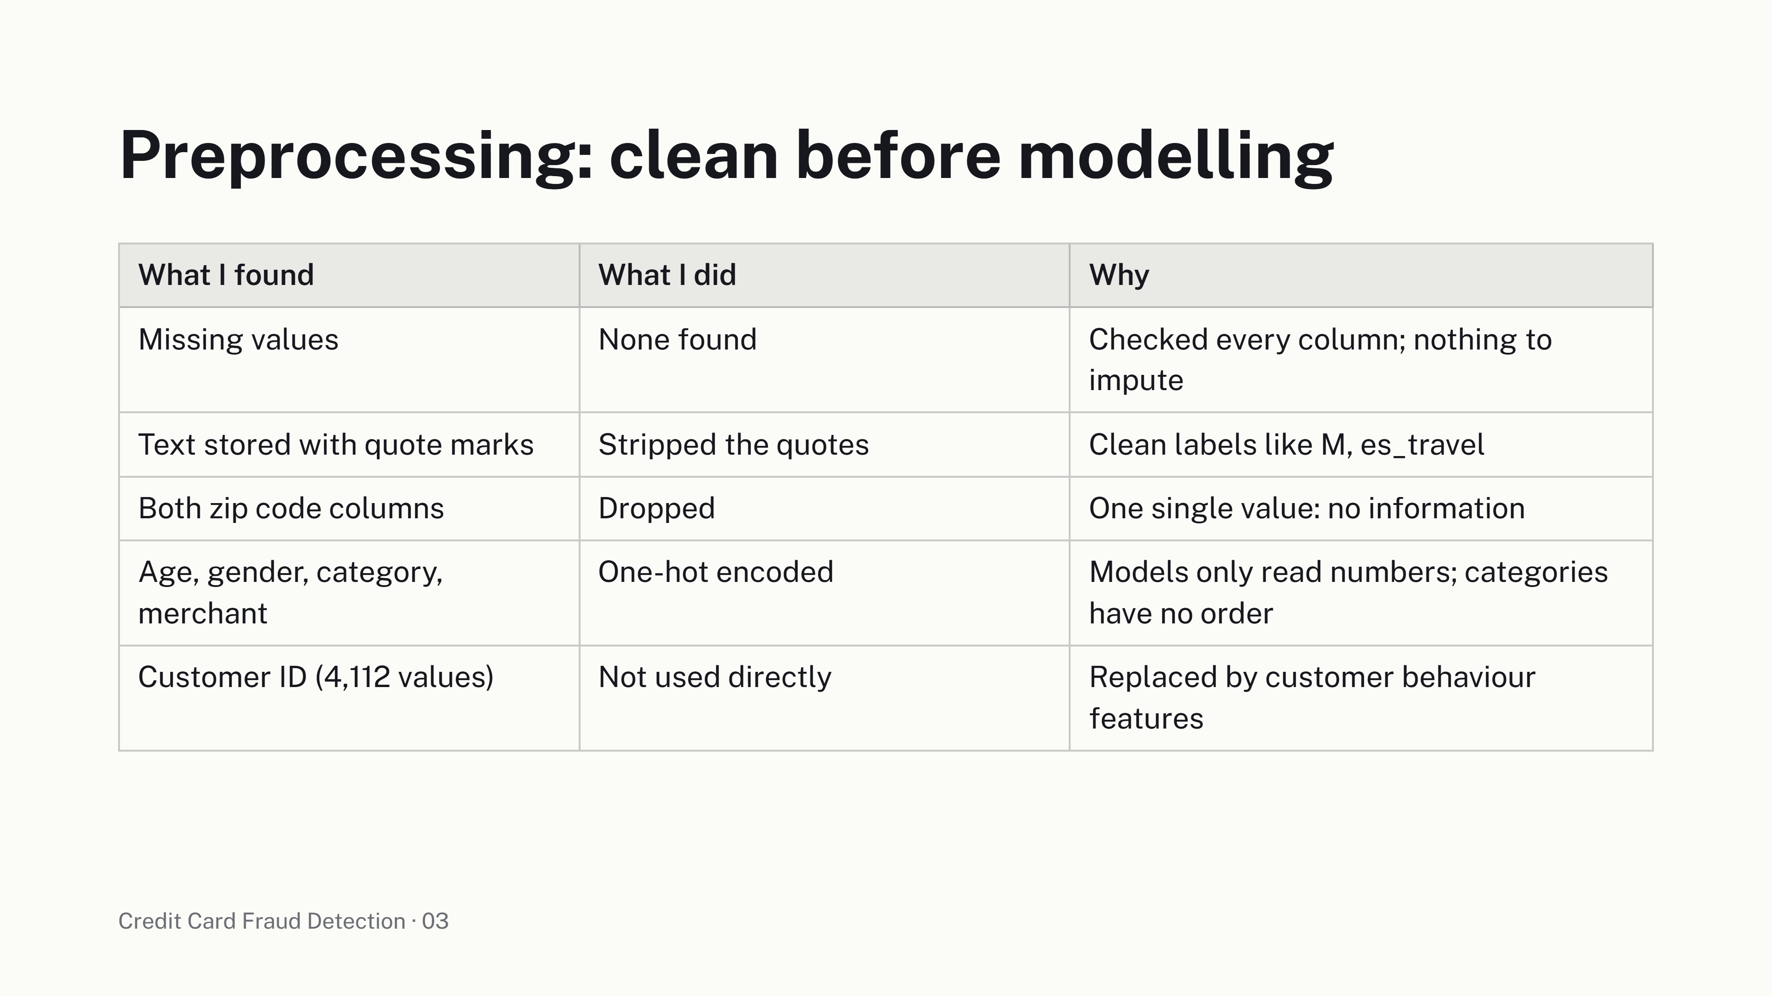
Preprocessing: clean before modelling
What I found
What I did
Why
Missing values
None found
Checked every column; nothing to
impute
Text stored with quote marks
Stripped the quotes
Clean labels like M, es_travel
Both zip code columns
Dropped
One single value: no information
Age, gender, category,
One-hot encoded
Models only read numbers; categories
merchant
have no order
Customer ID (4,112 values)
Not used directly
Replaced by customer behaviour
features
Credit Card Fraud Detection · 03

Slide 4
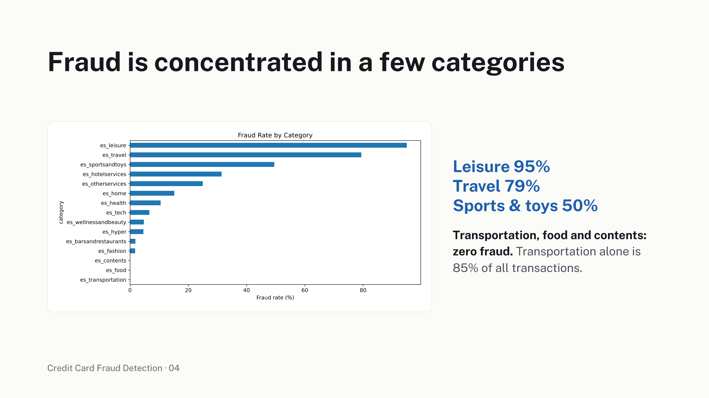
Fraud is concentrated in a few categories
Leisure 95%
Travel 79%
Sports & toys 50%
Transportation, food and contents:
zero fraud.
Transportation alone is
85% of all transactions.
Credit Card Fraud Detection · 04

Slide 5
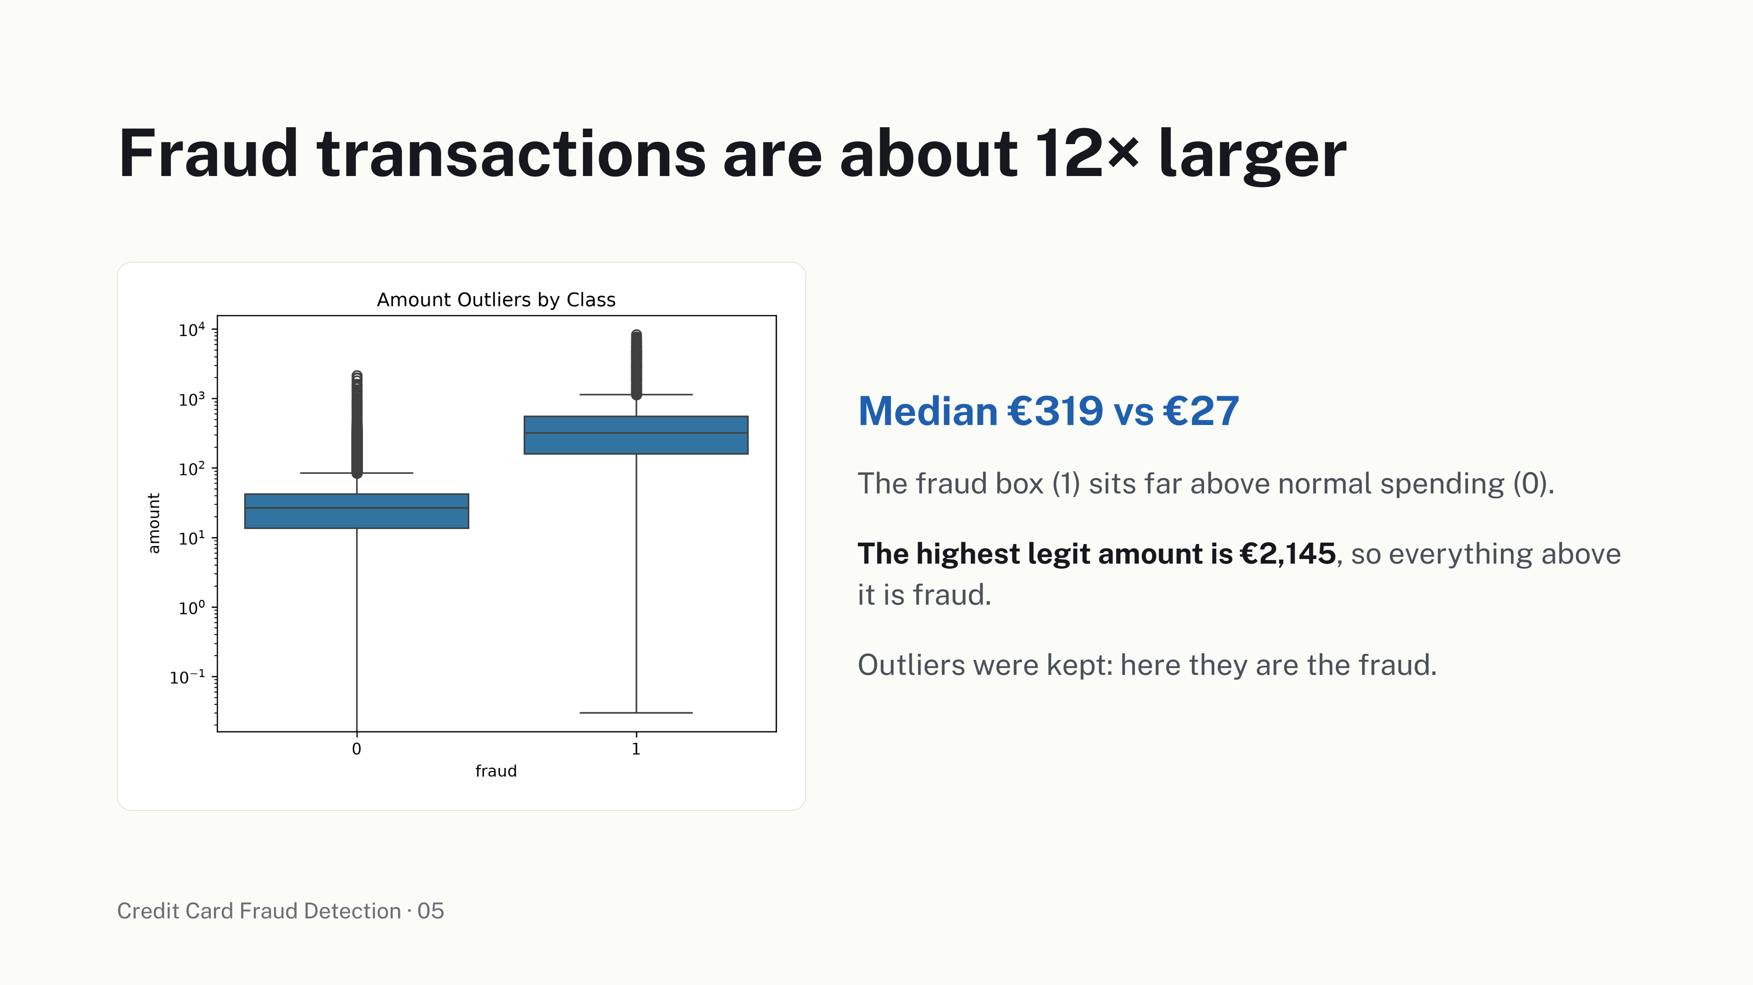
Fraud transactions are about 12× larger
Median €319 vs €27
The fraud box (1) sits far above normal spending (0).
The highest legit amount is €2,145
, so everything above
it is fraud.
Outliers were kept: here they are the fraud.
Credit Card Fraud Detection · 05

Slide 6
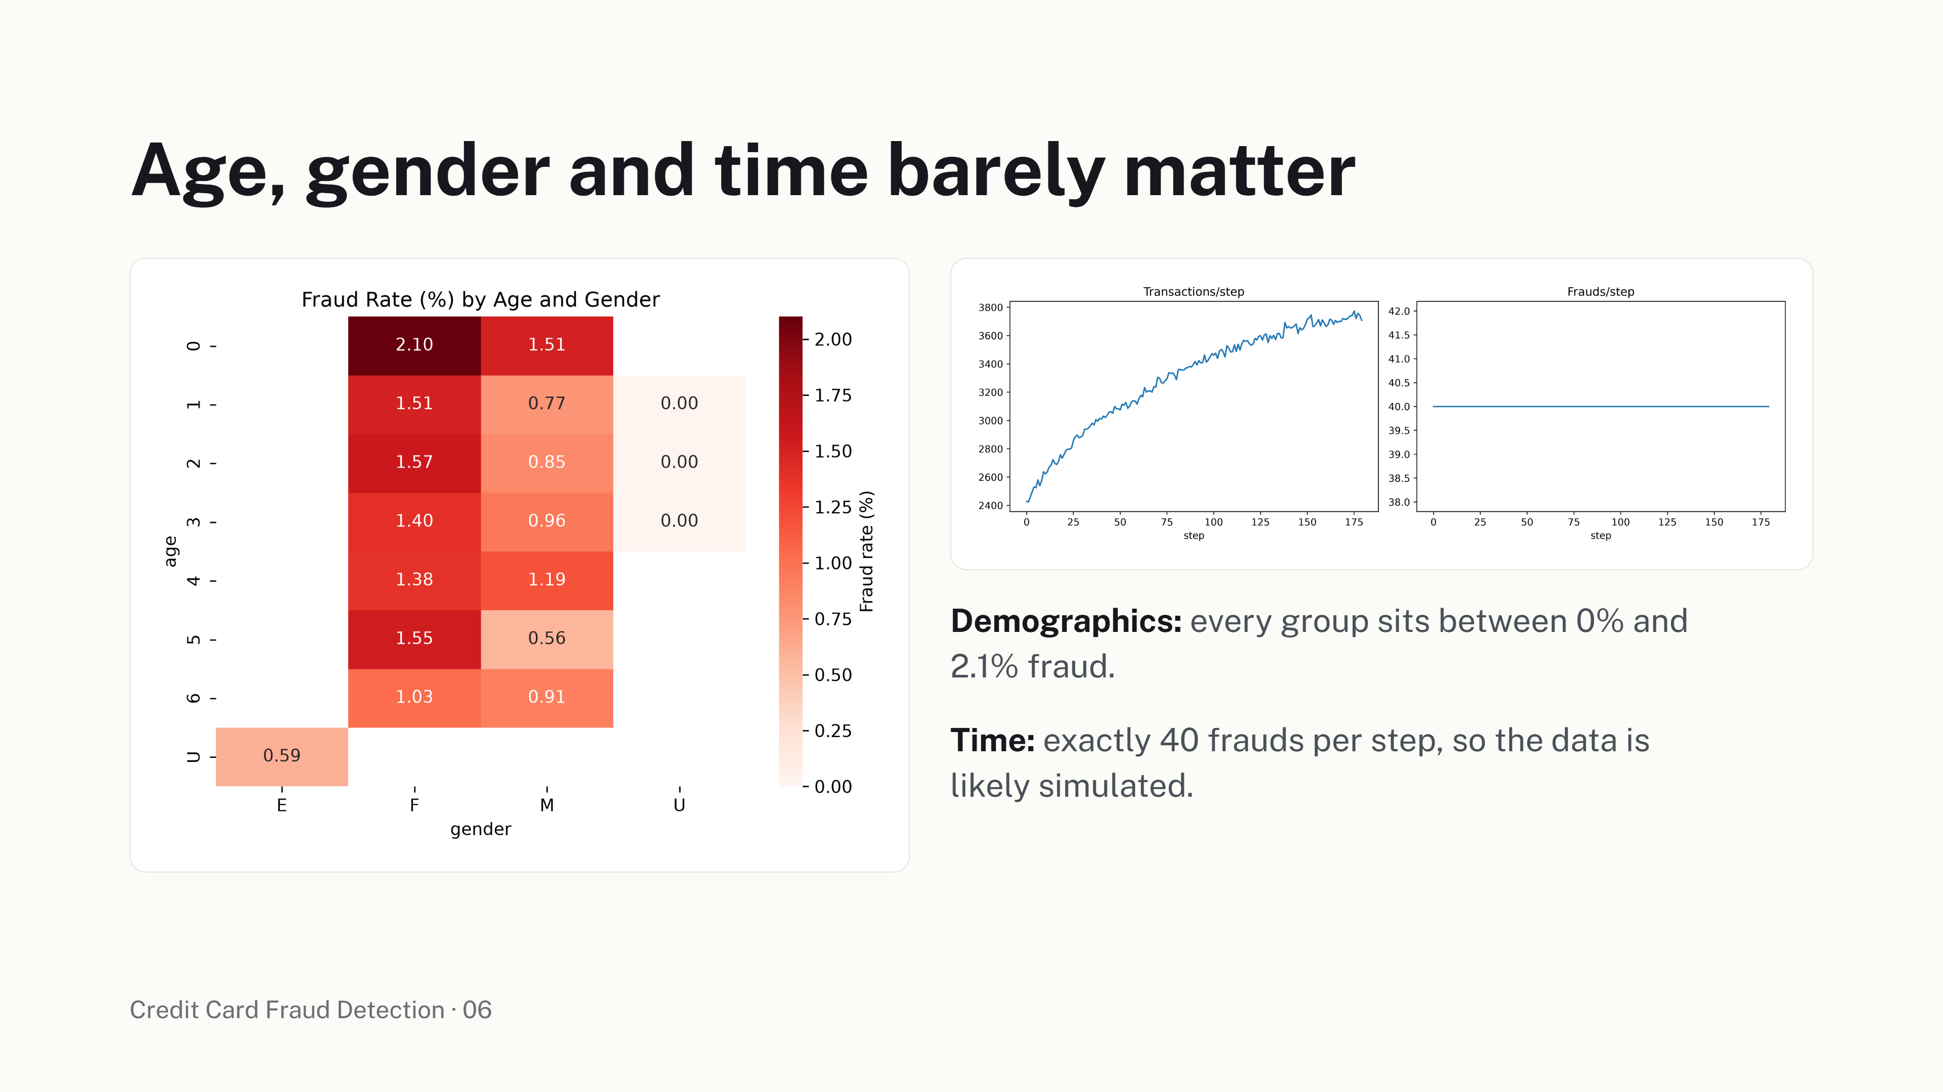
Age, gender and time barely matter
Demographics:
every group sits between 0% and
2.1% fraud.
Time: exactly 40 frauds per step, so the data is
likely simulated.
Credit Card Fraud Detection · 06

Slide 7
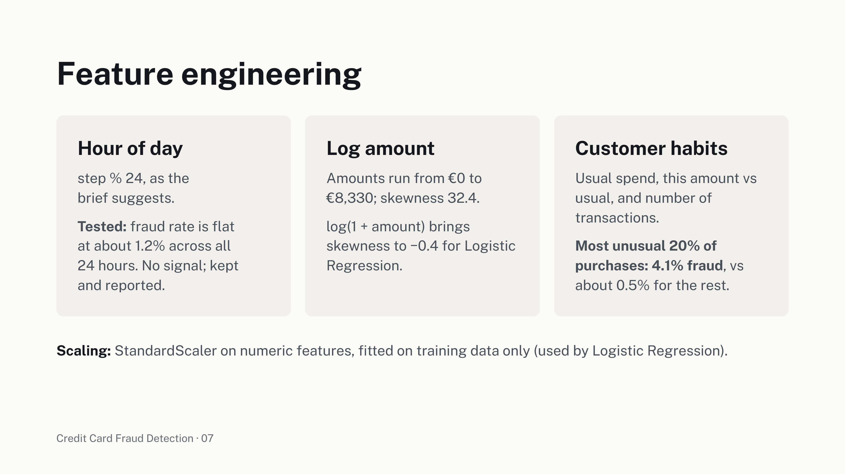
Feature engineering
Hour of day
Log amount
Customer habits
step % 24, as the
Amounts run from €0 to
Usual spend, this amount vs
brief suggests.
€8,330; skewness 32.4.
usual, and number of
Tested:
fraud rate is flat
log(1 + amount) brings
transactions.
at about 1.2% across all
skewness to −0.4 for Logistic
Most unusual 20% of
24 hours. No signal; kept
Regression.
purchases: 4.1% fraud
, vs
and reported.
about 0.5% for the rest.
Scaling:
StandardScaler on numeric features, fitted on training data only (used by Logistic Regression).
Credit Card Fraud Detection · 07

Slide 8
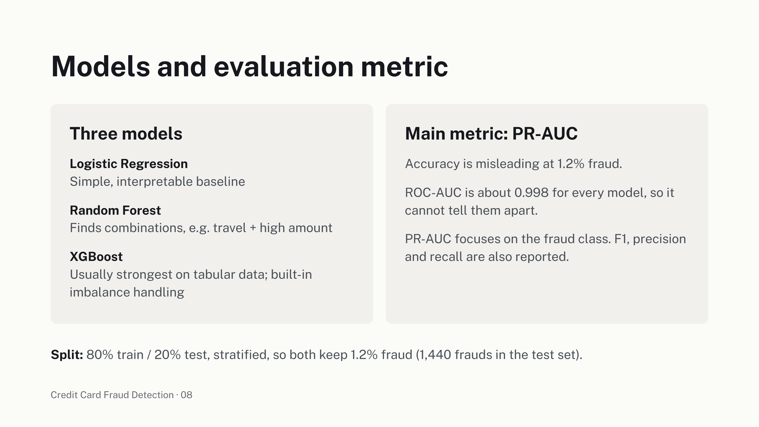
Models and evaluation metric
Three models
Main metric: PR-AUC
Logistic Regression
Accuracy is misleading at 1.2% fraud.
Simple, interpretable baseline
ROC-AUC is about 0.998 for every model, so it
Random Forest
cannot tell them apart.
Finds combinations, e.g. travel + high amount
PR-AUC focuses on the fraud class. F1, precision
XGBoost
and recall are also reported.
Usually strongest on tabular data; built-in
imbalance handling
Split:
80% train / 20% test, stratified, so both keep 1.2% fraud (1,440 frauds in the test set).
Credit Card Fraud Detection · 08

Slide 9
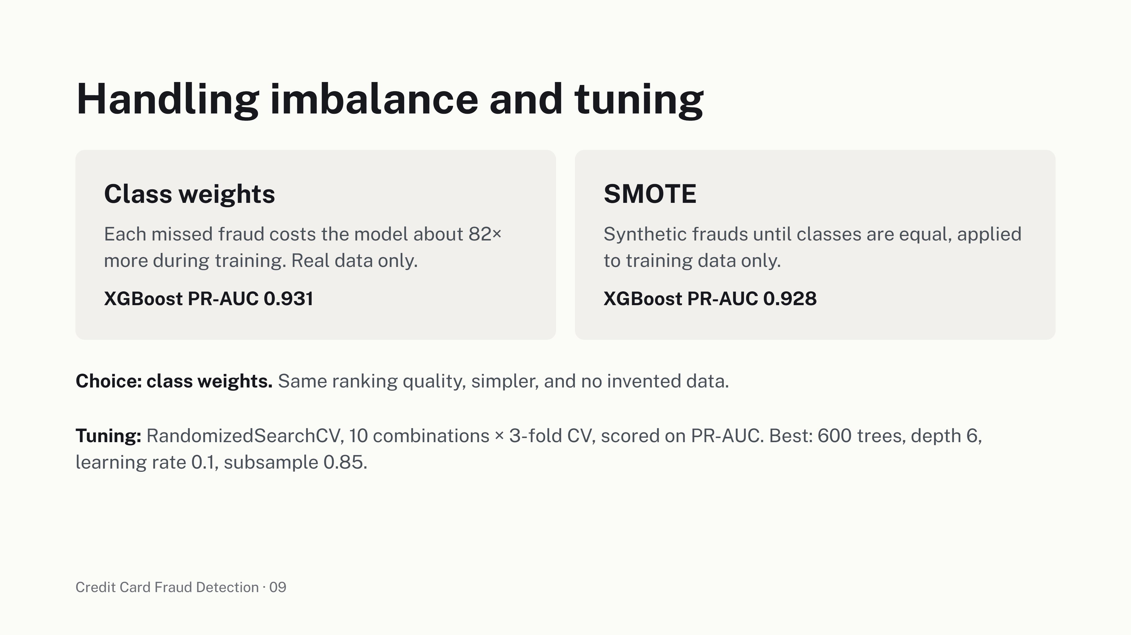
Handling imbalance and tuning
Class weights
SMOTE
Each missed fraud costs the model about 82×
Synthetic frauds until classes are equal, applied
more during training. Real data only.
to training data only.
XGBoost PR-AUC 0.931
XGBoost PR-AUC 0.928
Choice: class weights.
Same ranking quality, simpler, and no invented data.
Tuning:
RandomizedSearchCV, 10 combinations × 3-fold CV, scored on PR-AUC. Best: 600 trees, depth 6,
learning rate 0.1, subsample 0.85.
Credit Card Fraud Detection · 09

Slide 10
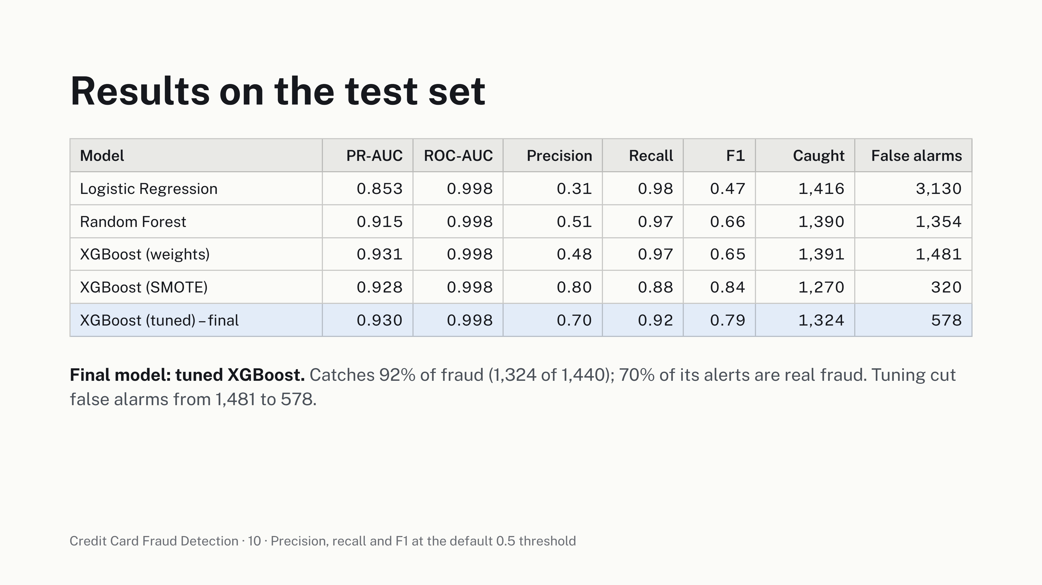
Results on the test set
Model
PR-AUC
ROC-AUC
Precision
Recall
F1
Caught
False alarms
Logistic Regression
0.853
0.998
0.31
0.98
0.47
1,416
3,130
Random Forest
0.915
0.998
0.51
0.97
0.66
1,390
1,354
XGBoost (weights)
0.931
0.998
0.48
0.97
0.65
1,391
1,481
XGBoost (SMOTE)
0.928
0.998
0.80
0.88
0.84
1,270
320
XGBoost (tuned) – final
0.930
0.998
0.70
0.92
0.79
1,324
578
Final model: tuned XGBoost.
Catches 92% of fraud (1,324 of 1,440); 70% of its alerts are real fraud. Tuning cut
false alarms from 1,481 to 578.
Credit Card Fraud Detection · 10 · Precision, recall and F1 at the default 0.5 threshold

Slide 11
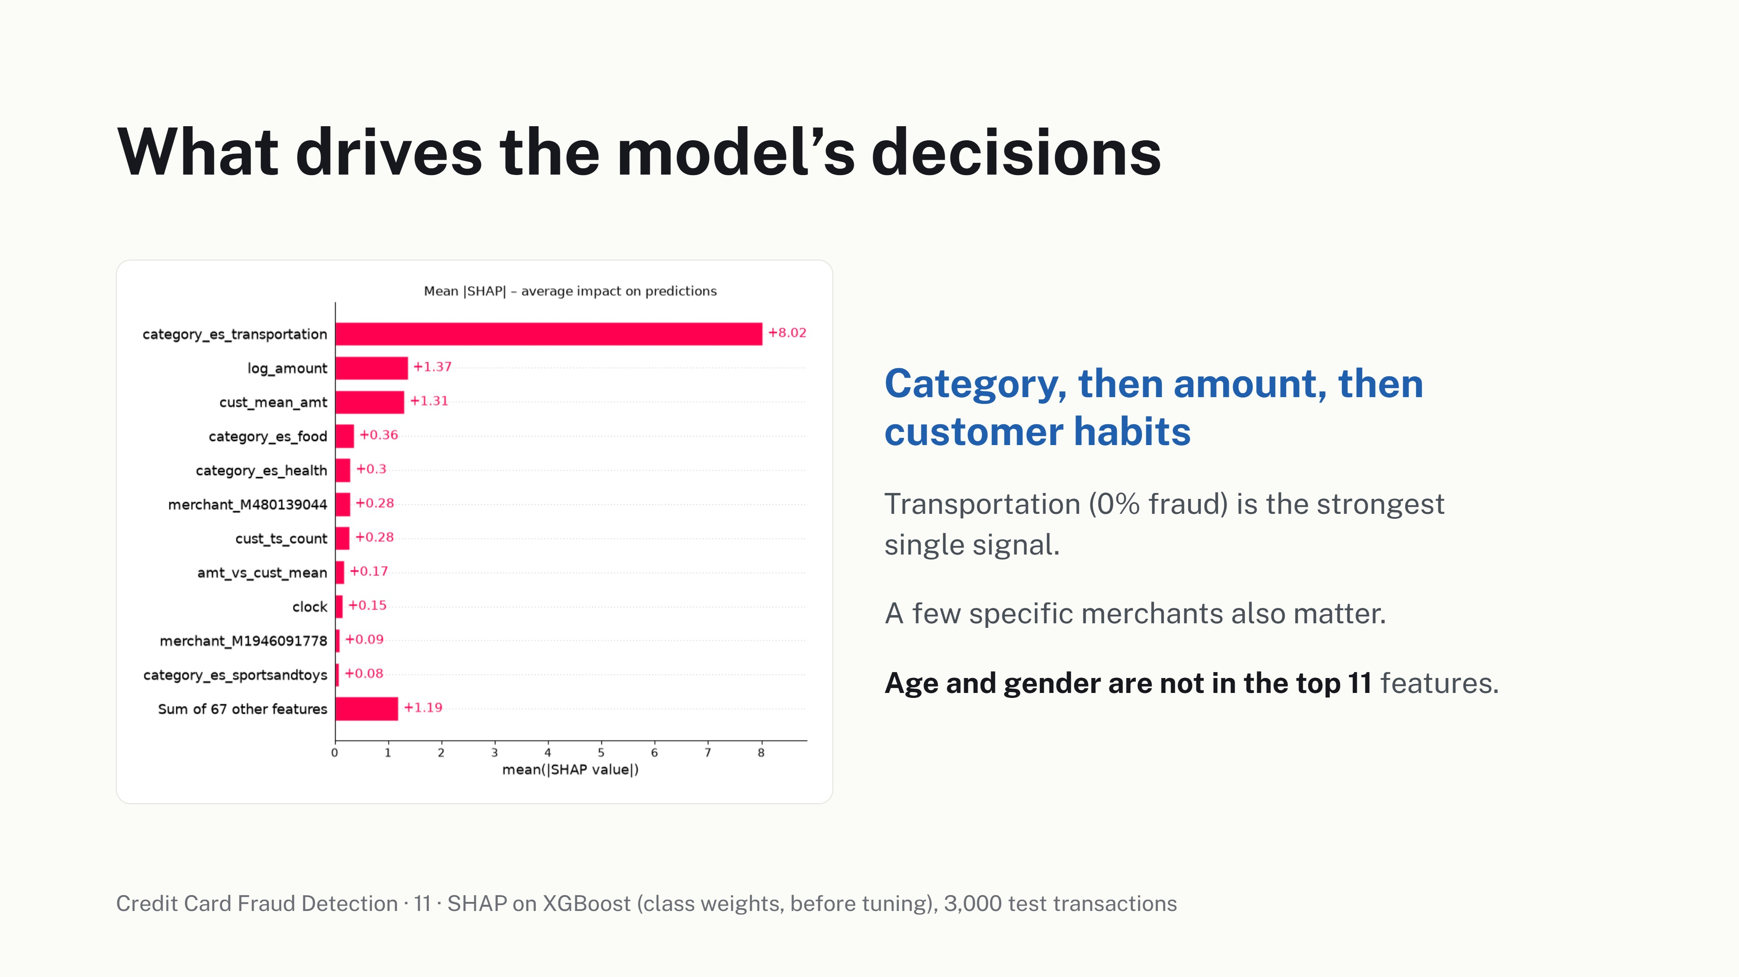
What drives the model’s decisions
Category, then amount, then
customer habits
Transportation (0% fraud) is the strongest
single signal.
A few specific merchants also matter.
Age and gender are not in the top 11 features.
Credit Card Fraud Detection · 11 · SHAP on XGBoost (class weights, before tuning), 3,000 test transactions

Slide 12
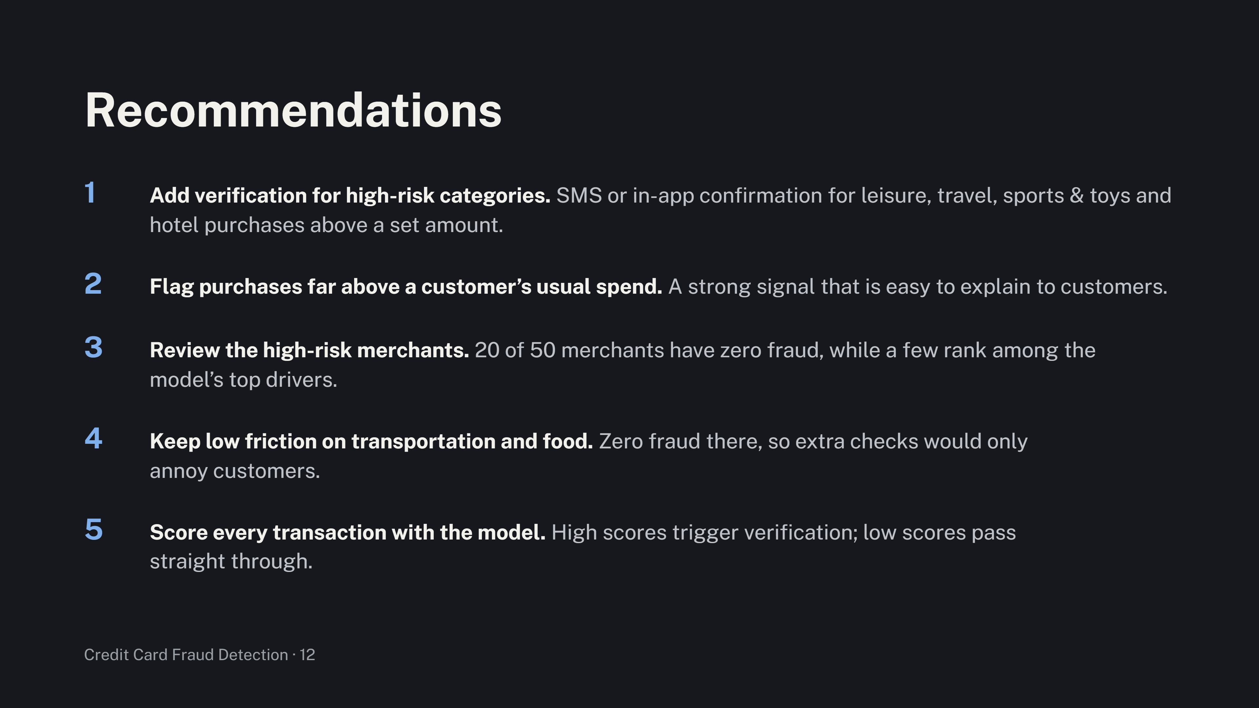
Recommendations
1
Add verification for high-risk categories.
SMS or in-app confirmation for leisure, travel, sports & toys and
hotel purchases above a set amount.
2
Flag purchases far above a customer’s usual spend. A strong signal that is easy to explain to customers.
3
Review the high-risk merchants.
20 of 50 merchants have zero fraud, while a few rank among the
model’s top drivers.
4
Keep low friction on transportation and food.
Zero fraud there, so extra checks would only
annoy customers.
5
Score every transaction with the model.
High scores trigger verification; low scores pass
straight through.
Credit Card Fraud Detection · 12

Slide 13
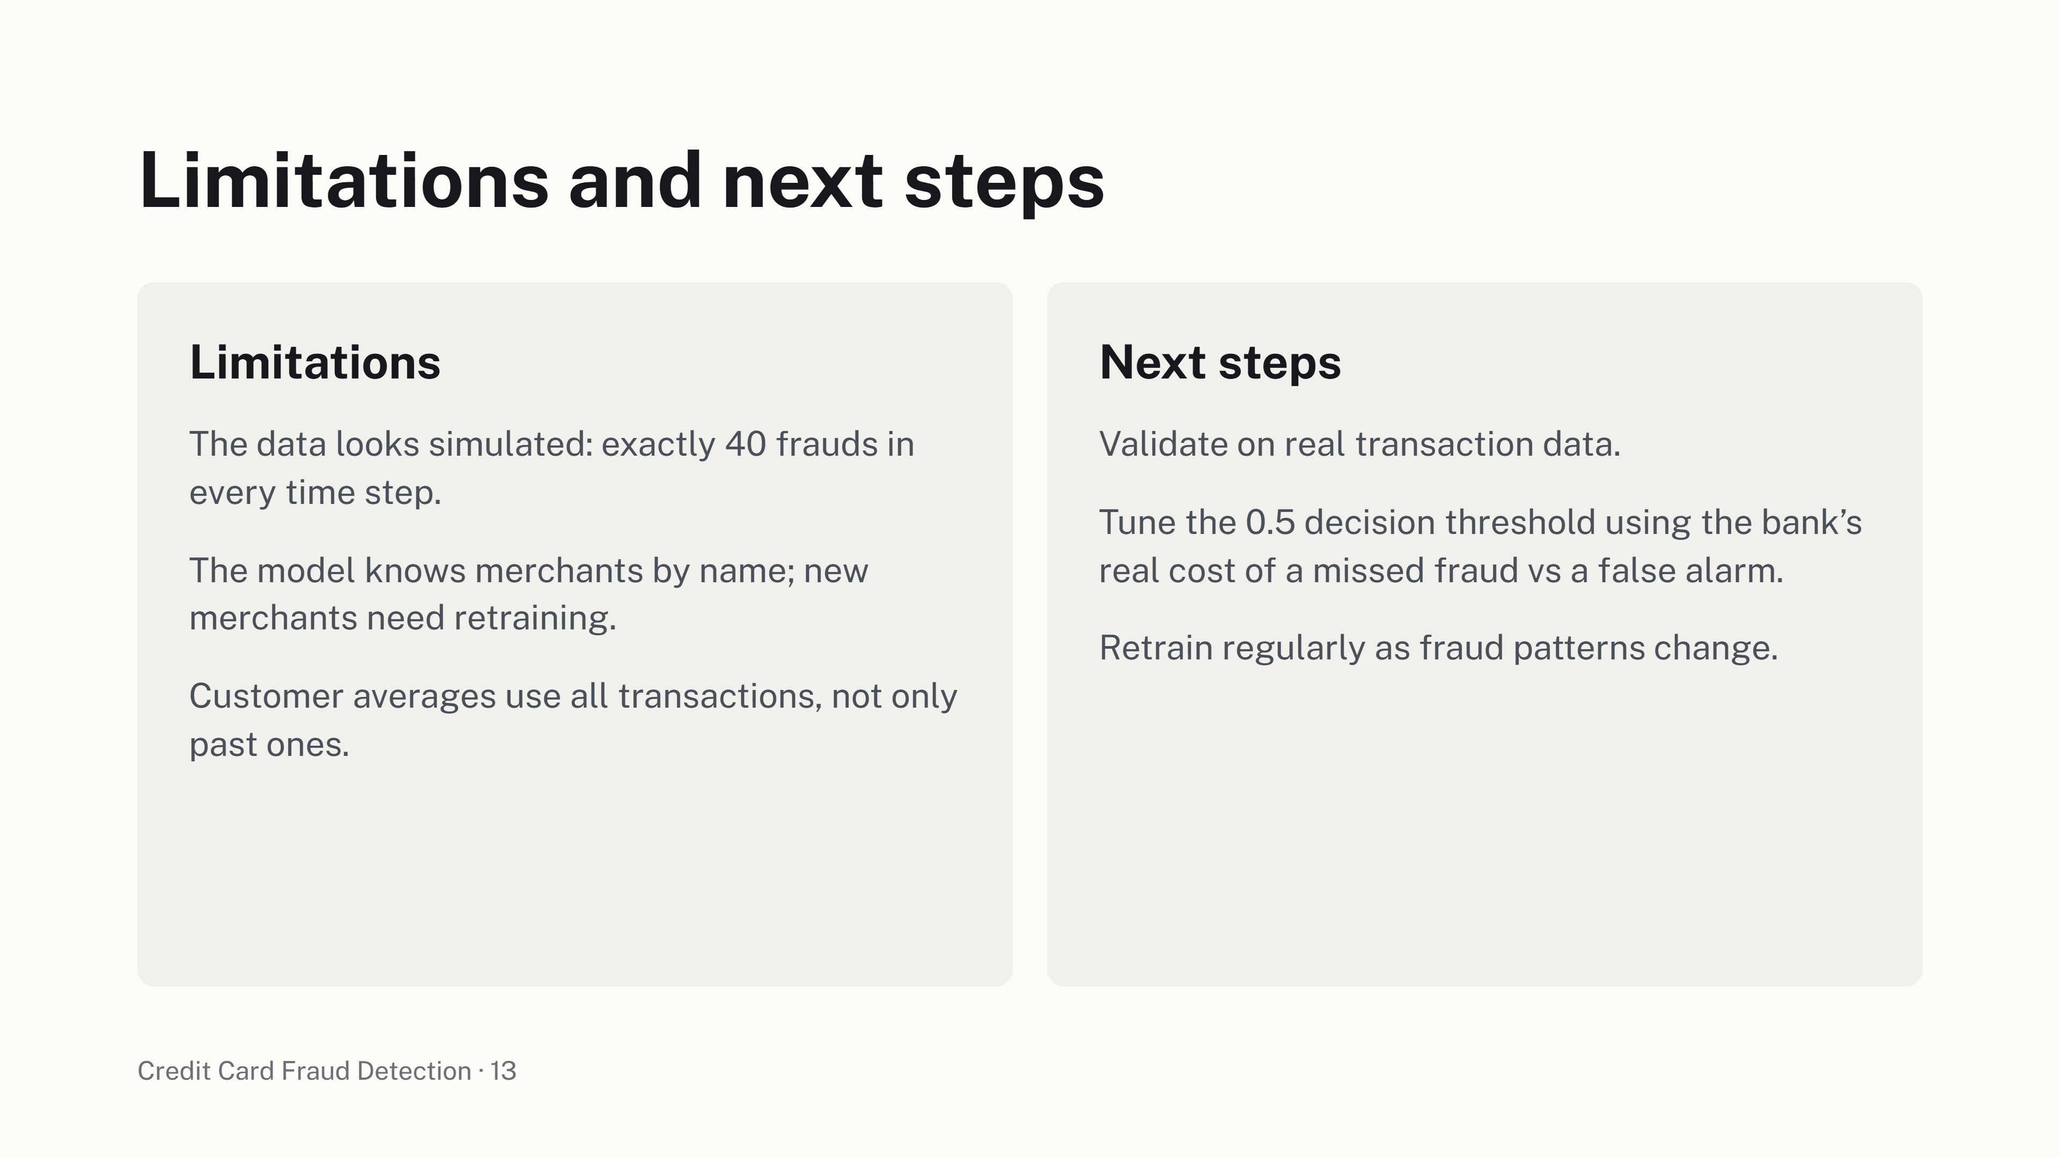
Limitations and next steps
Limitations
Next steps
The data looks simulated: exactly 40 frauds in
Validate on real transaction data.
every time step.
Tune the 0.5 decision threshold using the bank’s
The model knows merchants by name; new
real cost of a missed fraud vs a false alarm.
merchants need retraining.
Retrain regularly as fraud patterns change.
Customer averages use all transactions, not only
past ones.
Credit Card Fraud Detection · 13

